Slide 1
Parsing Regular Expressions in Agda
Computer Science
University of Birmingham

Slide 2
Project Objectives
Translating from regular expressions to automata
Regex → Minimised DFA
Proving their correctness in Agda
e.g. ∀e. L(e) = L(regexToDFA e)
Formalising Myhill-Nerode Theorem

Slide 3
Motivation
Parsing is important, blah blah blah
The proof is non-trivial

Slide 4
Agda
Dependently typed programming language
Dependent type
A type that is indexed by a value of a type
Vec Nat n e.g. Vec Nat 1 , Vec Nat 10
Gives more precise types
e.g. Binary search tree
Related to predicate logic
Notes:
Similar to Haskell, but provide more expressive types, Haskell -> Binary tree, Agda -> BinarySearchTrees
Different use of dependent types, represents logic

Slide 5
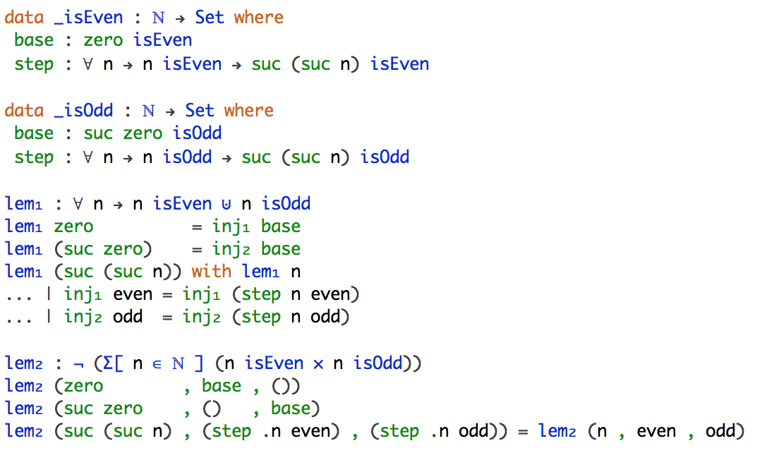
Agda
Encoding predicate logic

Slide 6
Agda
Dependently typed programming language
Dependent type
A type that is indexed by a value of other type
Vec Nat n e.g. Vec Nat 1 , Vec Nat 10
Gives more precise types
e.g. Binary search tree
Related to predicate logic
Proof assistant
Write programs
Prove their correctness

Slide 7
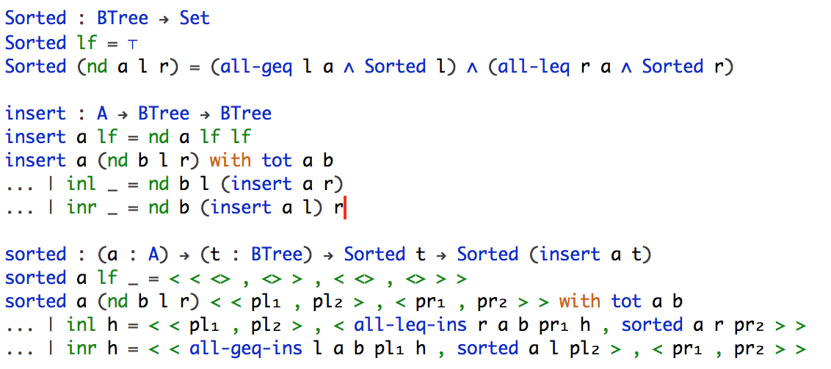
Agda
Encoding specification of program

Slide 8
Project Objectives
Translating from regular expressions to automata
Regex → Minimised DFA
Proving their correctness in Agda
e.g. ∀e. L(e) = L(regexToDFA e)
Formalising Myhill-Nerode Theorem

Slide 9
Formalisation (Part 1 & 2)
Thompson’s Construction
Remove ε-transitions
Powerset construction
Remove unreachable states and perform quotient construction
Prove that
L(Regex) = L(ε-NFA) = L(NFA) = L(DFA) = L(MDFA)

Slide 10
Formalisation (Part 1 & 2)
Code snippet of Regex → ε-NFA
Define Regular Expression
Define ε-NFA
Define the translation
Prove its correctness:
L(regex) = L(translated ε-NFA)

Slide 11
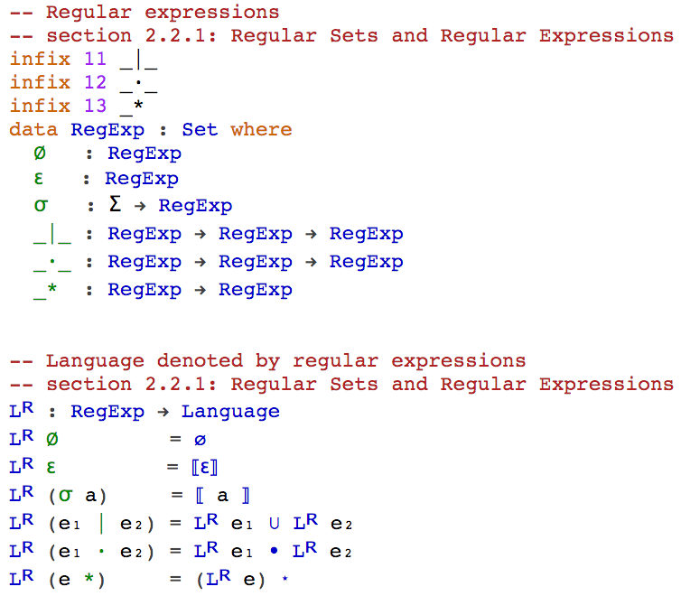
Formalisation (Part 1 & 2)
Define Regular Expression
Notes:
Here we dene regular expressions inductively over Σ as follow:
1. ∅ is a regular expression denoting the regular language ;
2. ε is a regular expression denoting the regular language {ε} ;
3. ∀a∈Σ. A is a regular expression denoting the regular language {a} ;
4. if e₁ and e₂ are regular expressions denoting the regular languages L₁ and L₂ respectively, then
(a) e₁ | e₂ is a regular expressions denoting the regular language L₁∪ L₂;
(b) e₁ ∙ e₂ is a regular expression denoting the regular language L₁ ∙ L₂;
(c) e₁ * is a regular expression denoting the regular language L₁*.

Slide 12
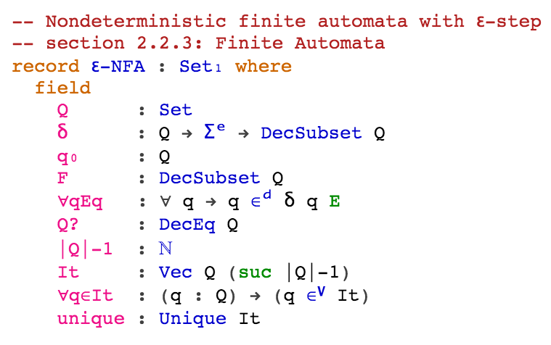
Formalisation (Part 1 & 2)
Define ε-NFA
An ε-NFA is a 5-tuple M = (Q, Σ^{e}, δ, q₀ , F), where
1. Q is a finite set of states;
2. Σ^{e} is the union of Σ and {ε};
3. δ is a mapping from Q × Σ^{e} to P(Q) which defines the behaviour of the automata;
4. q₀ in Q is the initial state;
5. F ⊆ Q is the set of accepting states.

Slide 13
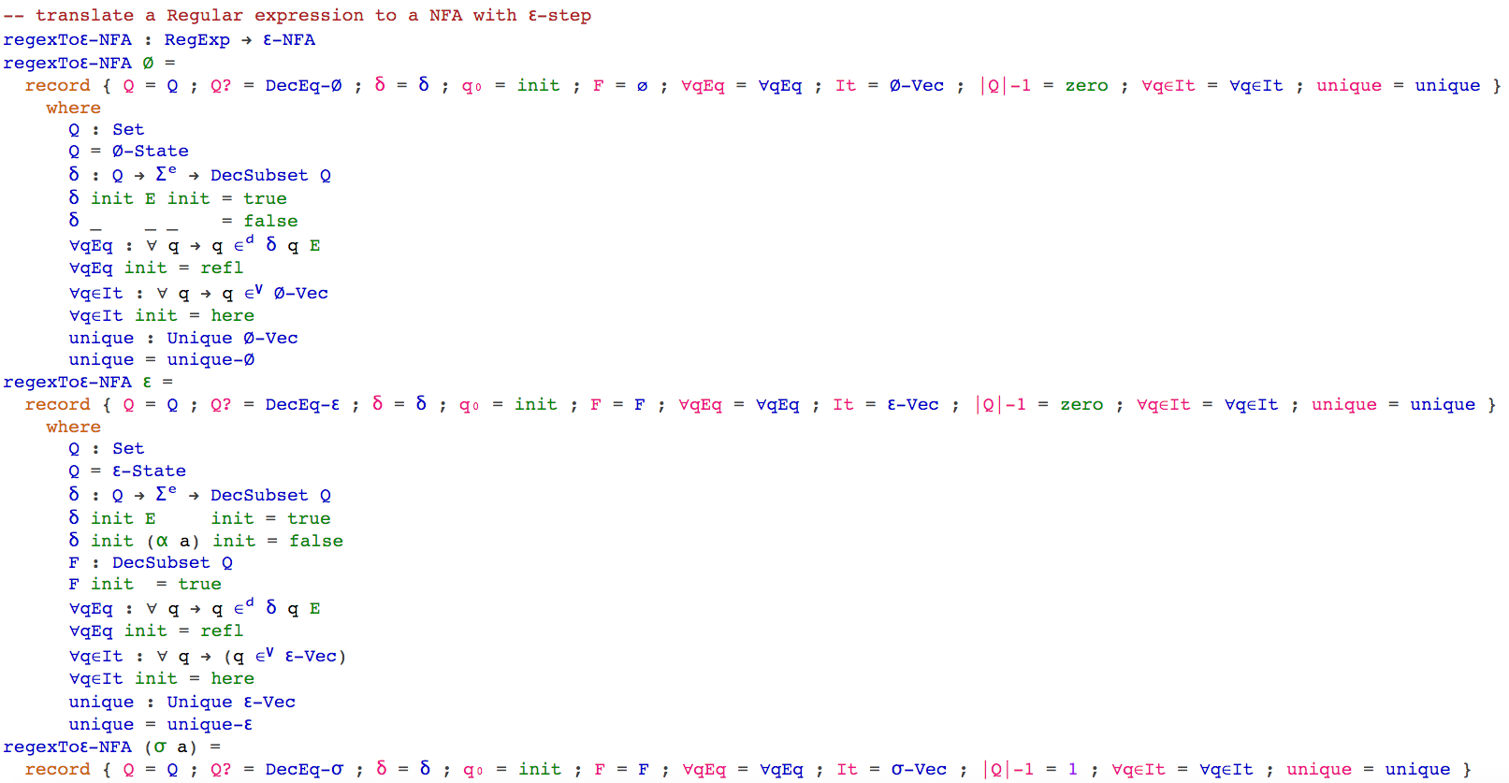
Formalisation (Part 1 & 2)
Define the translation Regex → ε-NFA

Slide 14
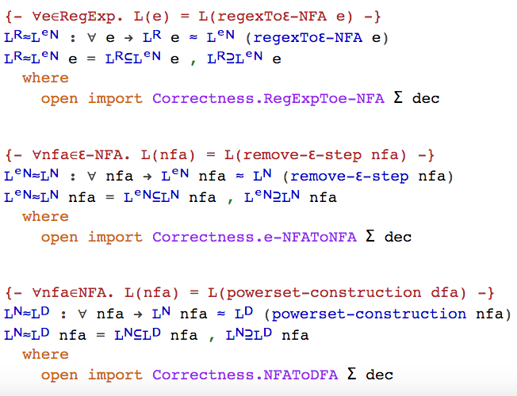
Formalisation (Part 1 & 2)
L(regex) = L(translated ε-NFA)

Slide 15
Formalisation (Part 3)

Slide 16
Work done
Formalising Regular Expression and Automata
Define Subset and its operations ✓
Define Regular Expression and Automata ✓
Define the language specified by them ✓
Define the translation
Regex to ε-NFA ✓
Remove ε-step ✓
Powerset construction ✓
Minimisation 10%
Prove L(Regex) = L(DFA)
L(Regex) = L(ε-NFA) ✓
L(ε-NFA) = L(NFA) ✓
L(NFA) = L(DFA) ✓
L(DFA) = L(MDFA) 0%
Formalising Myhill-Nerode Theorem 10%

Slide 17
Evaluation

Slide 18
Conclusion

Slide 19
References
[1] Firsov, D. and Uustalu, T. (2013). Certified Parsing of Regular Languages. In: Gonthier, G. and Norrish, M. Certified Programs and Proofs. Melbourne: Springer International Publishing. p98-113.
[2] Aho, A. and Ullman, J. (1972). The Theory of Parsing, Translation and Compiling. Volume I: Parsing. United States of America: Prentice-Hall, Inc.
[3] Bove, A. and Dybjer, P. (2009). Dependent Types at Work. In: Bove, A., Barbosa, L., Pardo, A. and Pinto, J. Language Engineering and Rigorous Software Development. Berlin: Springer Berlin Heidelberg. p57-99.
[4] Norell, U. and Chapman, J. (2009). Dependently Typed Programming in Agda. In: Koopman, P., Plasmeijer, R. and Swierstra, D. Advanced Functional Programming. Berlin: Springer Berlin Heidelberg. p230-266.

Slide 20
Q & A

